Slide 1
Nuclear Fuel Performance
NE-533
Spring 2023

Slide 2
Notes
MOOSE project part 1 recap:
Generally pretty good
No one mentioned my mistake in listing LHR in the wrong units
I provided one transient equation in class, and a different one in Moodle: my fault
For those that had issues, verify that your code is working properly and you can get the right results before moving to part 2
All should perform some convergence testing on your meshes and timestep, if you haven’t done so

Slide 3
Paper assignment
I will have assign each of you a paper to read and review by tomorrow
if you have a preference on topic, please let me know ASAP
We will have 15 minute presentations from each person on April 11 and March 11 summarizing and analyzing their respective paper
Papers available on Moodle
Everyone will upload their slides into Moodle by 11:59 pm April 10

Slide 4
Last Time
The average grain size in UO₂ impacts fuel behavior and performance
The material lowers energy by having large grains grow at the expense of small grains
Fuel densification is driven by reduction in surface area of pores – continuation of sintering process
Five families of fission products which uniquely change the fuel behavior
Fission gas is released in three stages
Fission gas production and diffusion to grain boundaries
Grain boundary bubble nucleation, growth, and interconnection
Gas transport through interconnected bubbles to free surfaces
Fission gas release is measured using post-irradiation annealing and/or in pile experiments

Slide 5
Fission Gas Release
Fission gas release models attempt to predict the rate at which gas is released from the fuel
To model fission gas release, ideally, we must model all three stages of gas release
Diffusion of gas atoms to grain boundaries
Growth and interconnection of grain boundary bubbles
Transport of gas atoms through interconnected bubbles to free surfaces
The earliest models only considered Stage 1
Most models now consider stage 1 and 2
There are no models that consider all three stages, but some are under development

Slide 6
Booth Model
The Booth model is the earliest model of fission gas release and only considers stage 1
A grain is considered as a simple sphere
Gas atoms are released at the grain boundary
The model solves the diffusion equation in 1D spherical coordinates
Assumptions
c_{g}(r, t)
All grains are spheres of radius a
D is constant throughout the grain
Gas is produced uniformly throughout the grain
Gas is released once it reaches the grain boundary
Release
Gas atoms
Grain boundary
ICs and BCs
c_{g}(r, 0) = 0
c_{g,r}(0, t) = 0
c_{g}(a, t) = 0 (release)

Slide 7
Modeling post-irradiation annealing
The initial gas concentration is c_{g}⁰
No gas is produced
Solving this equation tells us the value of c_{g} at any radius or time
However, we want to know the fraction of gas atoms that have made it to the grain boundary
We use the flux at the grain boundary
Release
Gas atoms
Grain boundary
ICs and BCs
c_{g}(r, 0) = c_{g}⁰
c_{g,r}(0, t) = 0
c_{g}(a, t) = 0 (release)

Slide 8
Solving the Booth Model
This equation is solved using a Laplace transform after nondimensionalization
Will not go through the derivation (shown in Olander)
τ = D x t / a²
Release
Gas atoms
Grain boundary
τ < π⁻²
τ ≥ π⁻²

Slide 9
Booth Example
For a diffusion coefficient for Xe of D = 8e-15 cm²/s, what fraction of the fission gas trapped in an post-irradiation annealed fuel pellet has escaped after one hour? It has an average grain size of 10 microns
D = 8e-15 cm²/s
a = 10e-4 cm
t = 3600 s
Which f? τ = D x t/a² = 2.88E-4 < π⁻² = 0.101
f = 6*sqrt(8e-15*3600/(pi*(10e-4)^2)) – 3*8e-15*3600/(10e-4)^2 = 0.0181

Slide 10
Different expressions for fission gas release
Given the data from the previous example, can plot both
τ < π⁻²
τ > π⁻²

Slide 11
Modeling in-pile release
The initial gas concentration is 0
Gas is produced due to fission, where y is the chain yield (y = 0.3017 for Xe and Kr) and the fission rate
Gas can also decay, where λ is the decay constant
If we only consider stable stable products, λ = 0
For in pile release, the fraction is equal to
After solving with with a Laplace transform
The total gas production is gas atoms/cm³
Release
Gas atoms
Grain boundary
ICs and BCs
c_{g}(r, 0) = 0
c_{g,r}(0, t) = 0
c_{g}(a, t) = 0 (release)

Slide 12
Example
For a diffusion coefficient for Xe of D = 8e-15 cm²/s, what fraction of the fission gas trapped in an in-pile fuel pellet has escaped after one hour? It has an average grain size of 10 microns.
D = 8e-15 cm²/s
a = 10e-4 cm
We have a short time (t=3600 s), so we can use:
f = 4*sqrt(8e-15*3600/(pi*(10e-4)^2)) – 3/2*8e-15*3600/(10e-4)^2 = 0.0121

Slide 13
As time progresses, both the fraction released and the produced gas increase

Slide 14
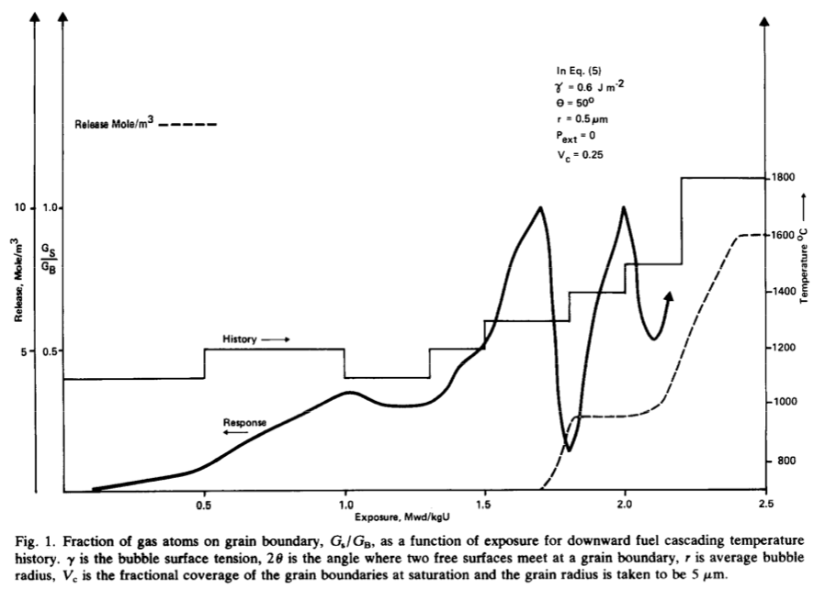
Forsberg-Massih model
The Booth model ONLY considers stage one of fission gas release
Two stage Forsberg-Massih mechanistic model
Considers intragranular diffusion diffusion to grain boundaries (stage 1)
Also, grain boundary gas accumulation, resolution back into grain, saturation (stage 2)
Assumes that once the bubbles on the grain face are interconnected, it is released (no stage 3)

Slide 15
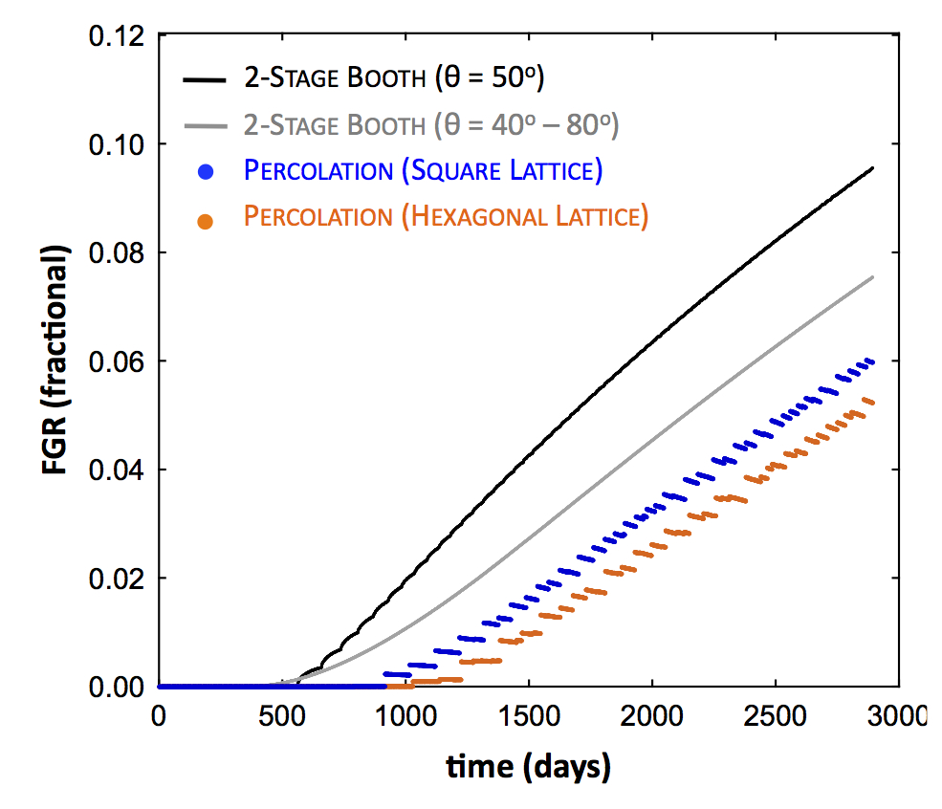
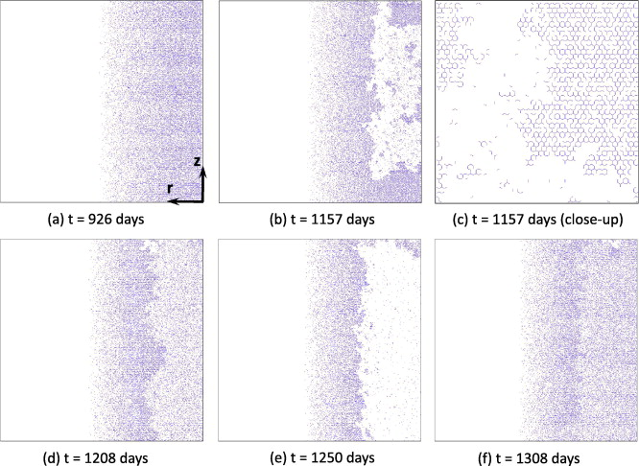
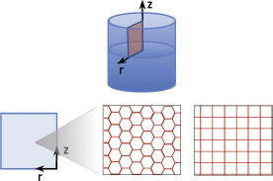
Forsberg-Massih model
2-stage F-M model over-predicts gas release because it neglects grain boundary bubble percolation (Stage 3)
Millett, Tonks, and Biner. JNM, 424.1 (2012): 176-182.

Slide 16
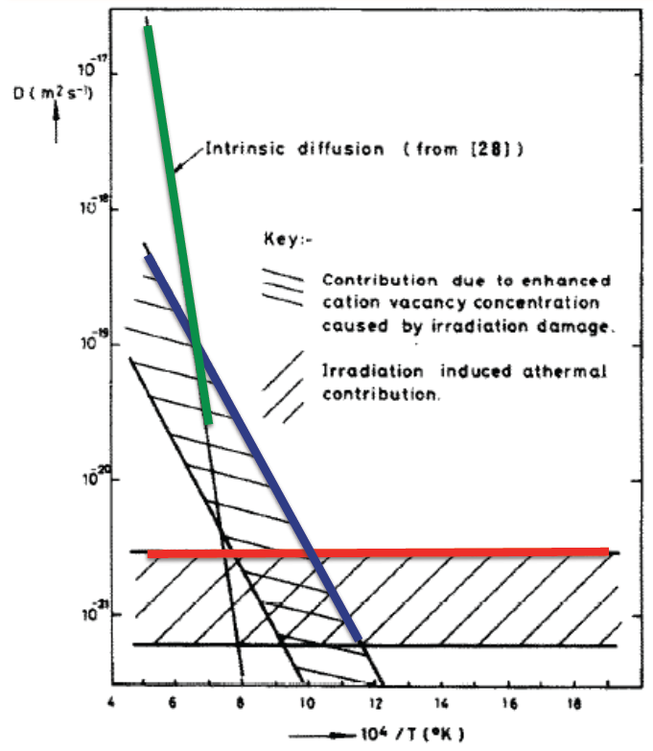
Gas diffusion
The diffusivity of the fission gas depends on temperature and on irradiation
Experimental data shows three different regimes for the diffusivity
D = D₁ + D₂ + D₃ cm²/s

Slide 17
Gas diffusion
The effective fission gas diffusivity is slower due to trapping by intragranular bubbles
As the gas atoms diffuse towards the grain boundary, some are trapped by the small intragranular bubbles
Some are later knocked out by energized particles (called resolution)
The effective diffusion constant depends on the trapping rate r_{t} and the resolution rate r_{r}

Slide 18
Summary
Fission gas release models are used to understand fission gas experiments and to predict gas release for fuel performance codes
Spherical grain models predict a fraction of gas release for post-irradiation annealing or for in-pile gas release
There are models which include 2nd and 3rd stages of fission gas release
Fission gas diffusivity behavior changes with temperature and fission rate

Slide 19
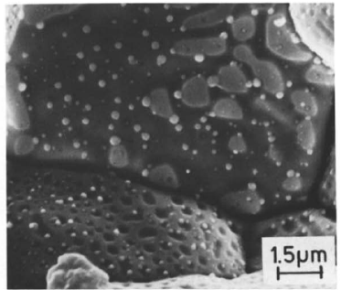
There are various types of fission products that form in the fuel
Soluble oxides (Y, La and the rare earths)
Dissolved in the cation sublattice
Insoluble oxides (Zr, Ba and Sr)
Form insoluble oxides in the fluorite lattice
Metals (Mo, Ru, Pd, and Tc)
Form metallic precipitates
Volatiles (Br, Rb, Te, I and Cs)
Exist as gases at high temperatures of the pellet interior
Also exist as solids at the cooler pellet exterior
Noble gases (Xe, Kr)
Essentially insoluble in the fuel matrix
Form either intragranular (within grain) voids or bubbles or intergranular (grain boundary) bubbles

Slide 20
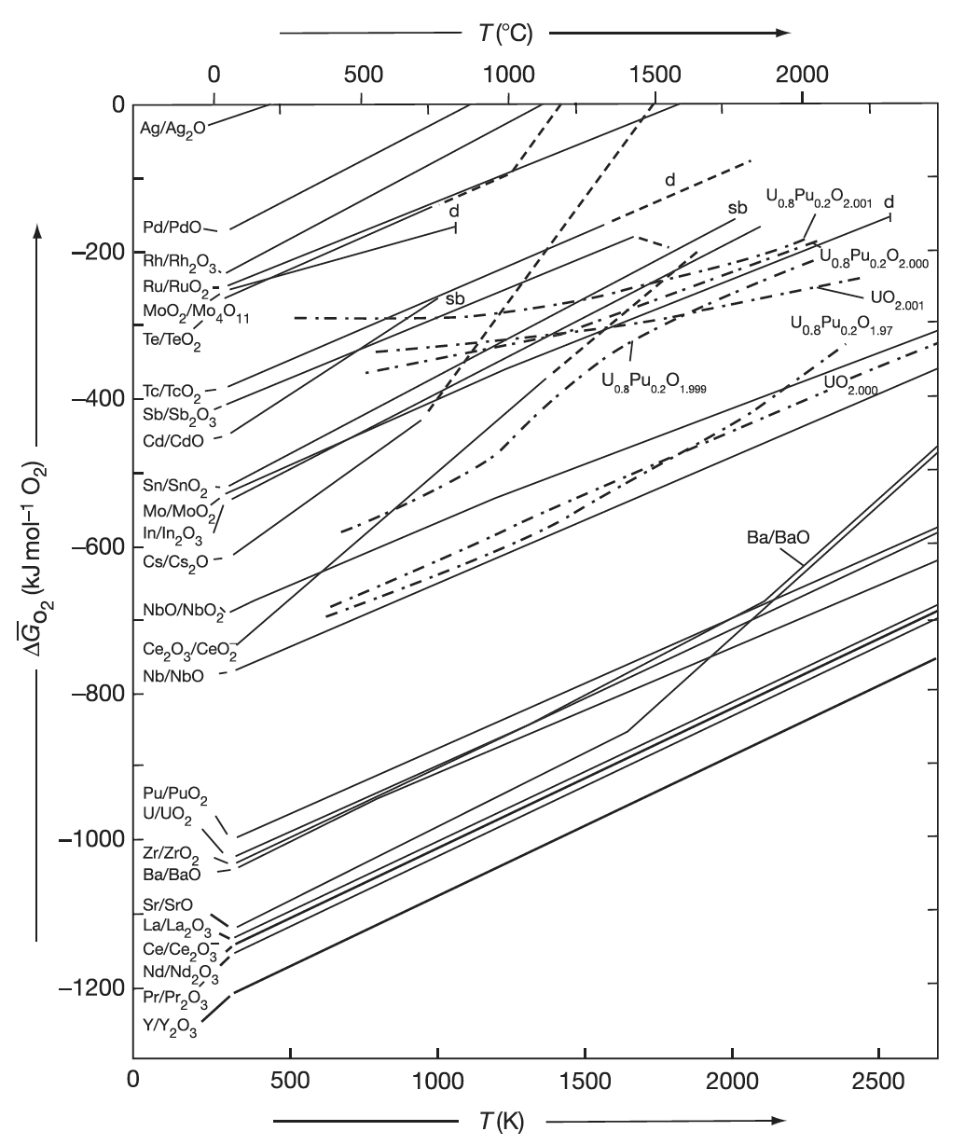
Oxide Formation
With burnup, the liberated oxygen will associate with U, Pu, and La but may not be in sufficient supply to combine with Pd and other less oxidizing elements
If the Gibbs energy of formation of the given fission product lies below the fuel oxygen potential, the element will be capable of forming an oxide
If the fission product point is above the chemical potential in the fuel, the fission product will exist as an element in the fuel (in a separate metallic phase)

Slide 21
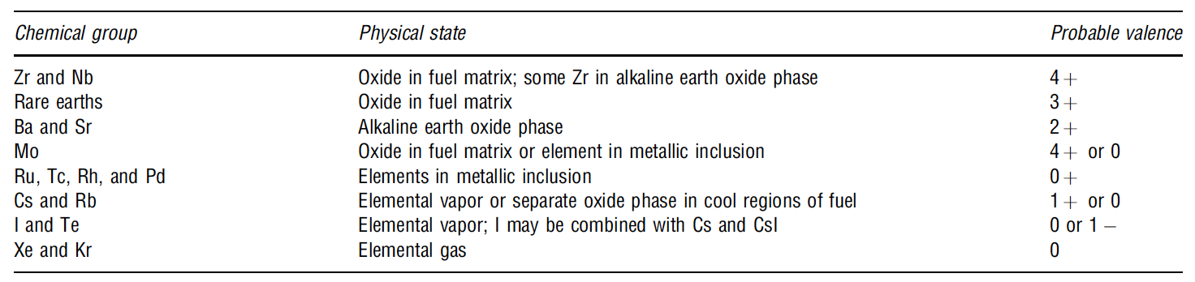
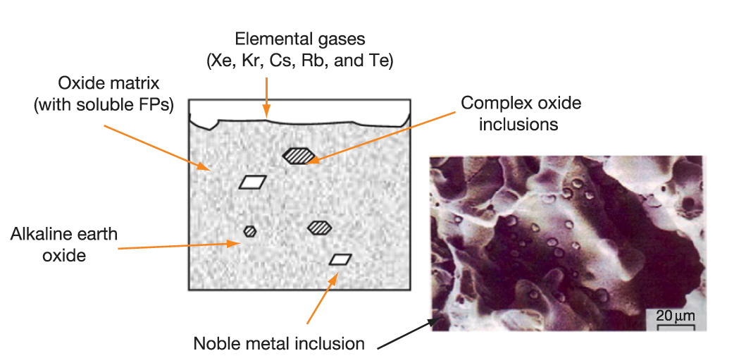
Soluble/Insoluble Fission Products
When a 4+ valence fission product (e.g.,Zr4+) enters the lattice, there is no change in the electrical neutrality
If the charge of the fission-product cation is lower than U+4, the site occupancy of the lattice is altered to achieve electrical neutrality
The alkaline earth cations Ba+ and Sr2+ have large ionic radii and form a separate oxide phase
Fission products that have limited solubility in UO2 will segregate to the grain boundaries and voids

Slide 22
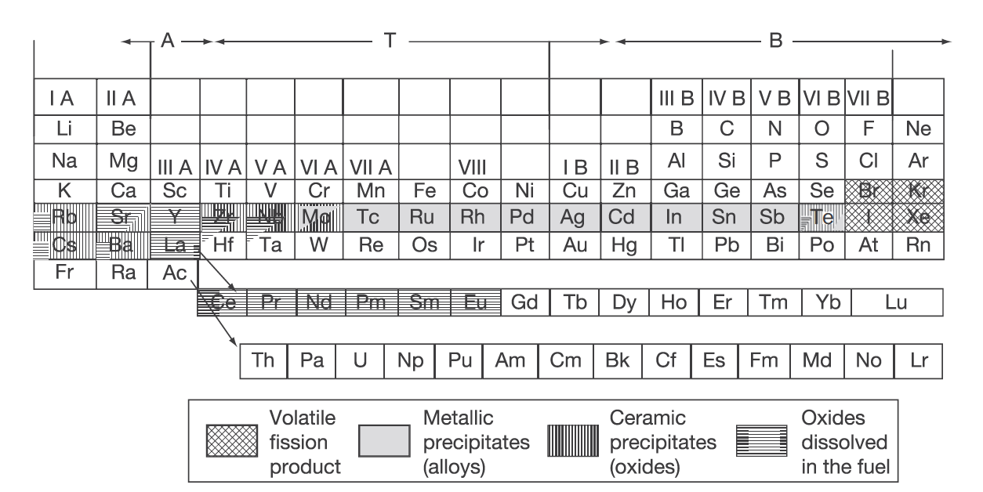
Volatile Fission Products
Xe release occurs at the central region of the pellet where the highest temperatures were achieved during irradiation
Volatile FPs are released from the fuel matrix similar to that of the noble gases
Volatile fission products in the gap can react among themselves, resulting in a changing chemical speciation
The kinetics of formation/decomposition of CsI and Zr iodides are possible factors in the mechanism of SCC

Slide 23
Fission Product Segregation
Fission products can be segregated because of their migration to specific locations such as intragranular segregations, grain boundaries, or pellet surfaces
Metallic inclusions are commonly observed in ceramographs from irradiated samples
They are formed by isotopes of Mo, Tc, Ru, Rh, Pd, Ag, Cd, In, Sn, Sb, and Te
These inclusions are found at the surface of the grain boundaries and are associated, in general, with grain boundary and intragranular bubbles
Some of the components of these precipitates can be oxidized or reduced forming other compounds of high volatility that can be released from the fuel matrix
Cs, Ru, Te, and Ba have been consistently found at the cracks in the pellet and on the clad inner surface
The white inclusions are metallic precipitates, which are composed of Mo, Tc, Rh, Ru, and Pd, form a quinary alloy in an hcp structure
A “gray oxide phase” perovskite structure containing different combinations of Ba, Cs, Zr, Mo, and U can also form

Slide 24
FP Interaction with Zr Cladding
Fission fragments will deposit on the inner surface of the cladding
Some of these species can diffuse into the cladding, while others can attack the cladding thereby initiating cracks that can later progress with the formation of through-wall cracks
Oxygen will diffuse into the cladding and contribute to its oxidation state
Measurements have shown deposits of Sr, Cs, Pu, and Am
The corrosion behavior of zirconium by Te has been reported
The chemical reaction between some corrosive fission products and the cladding can lead to PCI
Fission products such as Cs, Cd, or I can attack the cladding inducing crack initiation, which then progress through the cladding by intragranular and transgranular cracking modes

Slide 25
Fuel Swelling/Dimensional Change

Slide 26
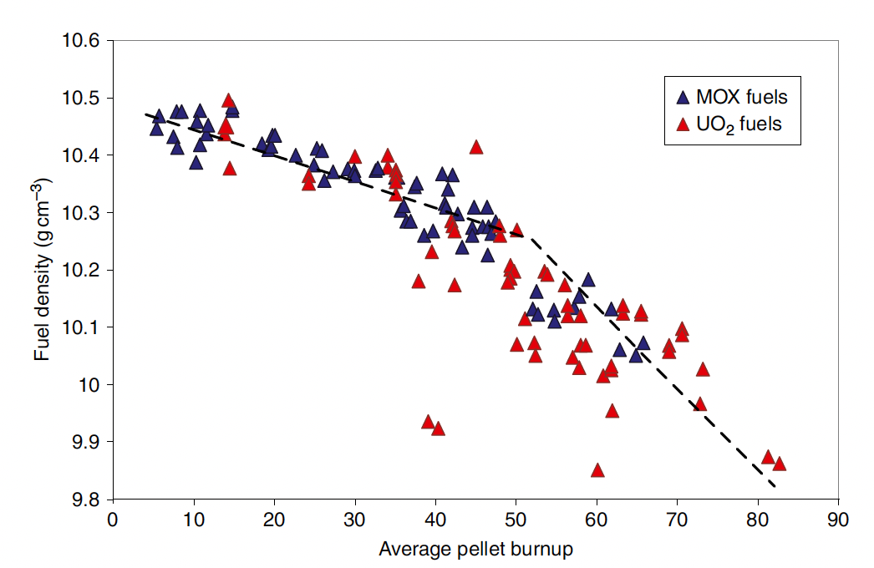
Fuel changes size and shape under reactor operation
Thermal expansion:
increase in volume, decrease in density, caused by increasing temperature
Densification:
Decrease in volume, increase in density, caused by shrinking of porosity left after sintering
Swelling:
Increase in volume, decrease in density, caused by fission products
Irradiation Creep:
Change in shape, constant density, occurs with applied stress less than σ_{y}

Slide 27
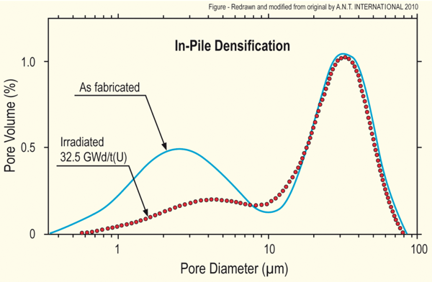
Densification
Densification takes place during initial 5 - 10 MWd/kgU
Small, as-built pores close due to effects of fission spikes and vacancy diffusion
Large pores stable (in absence of large hydrostatic stress)
Empirical correlation for densification is a function of
β - Burnup (in FIMA)
Δρ₀ – Total densification that can occur (a common value is 0.01)
β_{D} – Burnup at which densification stops ( a common value is 5 MWD/kgU)
C_{D} = 7.235 − 0.0086 (T(°C) − 25) for T < 750°C and CD = 1 for T ≥ 750 °C
[Maier et al, 1988]

Slide 28
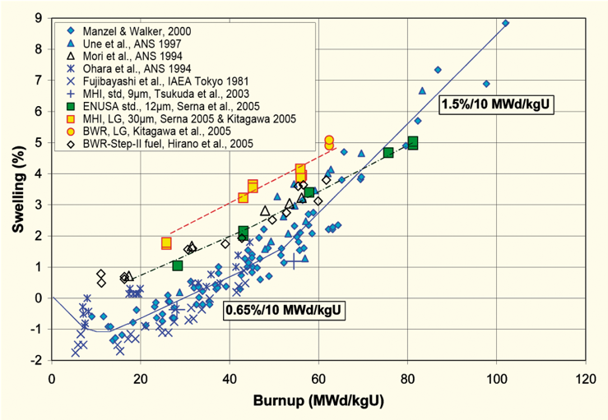
Fission product induced swelling
Fission product swelling results from three changes in the fuel microstructure
Solid swelling: Accumulation of soluble and insoluble fission products in fuel matrix
Gaseous swelling: Accumulation of gaseous and volatile fission products in intragranular and intergranular pores
High burnup swelling: Restructuring of pellet rim with the accumulation of fission gas in a large number of small pores
after Garzarolli in [Rudling et al, 2007]

Slide 29
Solid fission product swelling
The solid fission product swelling model is a function of:
Β – Burnup (in FIMA)
ρ – Initial UO₂ density (g/cm³)

Slide 30
Gaseous fission product swelling
Gaseous swelling varies strongly with temperature, fission rate and stress
T < 1000K
Fission gas atoms remain in fuel matrix or collect in small, isolated, intragranular pores (<1 nm)
Intragranular pore size limited by fission spikes that drive gas back into fuel matrix
Gaseous swelling constrained by fission gas release
T = 1000 to 1700 K
Swelling takes place at hot interior of pellet
Gas atoms in fuel matrix diffuse to grain boundaries and collect in pores
Gas pressure causes bubbles to increase in size and to coalesce into larger pores
Gaseous swelling opposed by applied stress
Gaseous swelling also constrained by fission gas release

Slide 31
Total change in volume
The total change in volume is found by adding all components of dimensional change
ε_{tot} = ε_{th} + ε_{D} + ε_{sfp} + ε_{gfp}
Example:
fission rate = 2.5e13 f/(cm³ s)
T(fuel) = 1400 K
T_{ref} = 300 K
For densification: Δρ₀ = 0.01 and β_{D} = 5 MWD/kgU
Total time: 2 weeks

Slide 32
Example

Slide 33
The overall swelling behavior depends on temperature

Slide 34
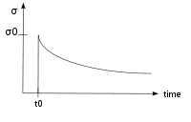
Creep
Creep is a general mechanism for plastic deformation that occurs over time when σ < σ_{y}
Consider a heated metal beam so it expands some distance dx
We then fix it between two walls and let it cool down
Because σ < σ_{y}, that stress remains constant
In creep, defect diffusion is induced by the stress to cause permanent deformation and reduce the stress
Therefore, creep
Occurs over time
Increases with increasing number of diffusing defects
High temperature (thermal creep)
Irradiation (irradiation creep)
x
x+dx
σ = E ε

Slide 35
Creep
General creep equation:
Creep can be caused by various microstructural mechanisms
Bulk Diffusion (Nabarro-Herring creep)
Atoms diffuse (high T), causing grains to elongate along the stress axis
Q = Q(self diffusion), m = 1, and b = 2
Grain boundary diffusion (Coble creep)
Atoms diffuse along grain boundaries to elongate the grains along the stress axis
Q = Q(grain boundary diffusion), m = 1, and b = 3
Dislocation creep
Dislocations glide under a high stress
Dislocations climb due to defects to avoid obstacles
Q = Q(self diffusion), m = 4–6, and b = 0

Slide 36
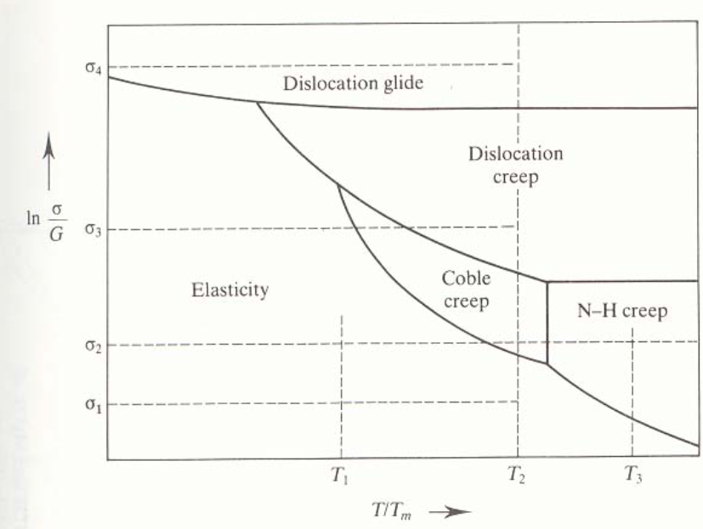
Different creep mechanisms are active for different combinations of stress and temperature

Slide 37
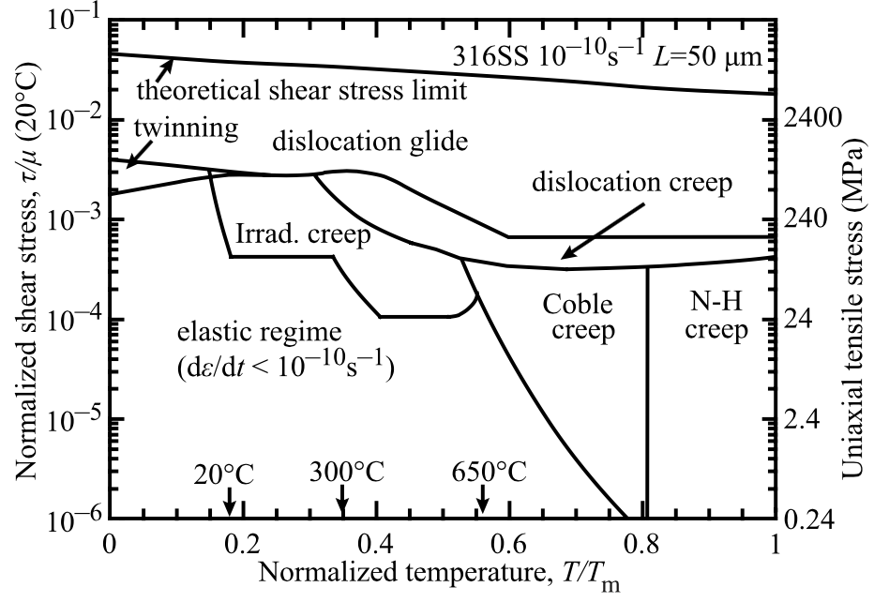
The behavior of creep changes in irradiated materials

Slide 38
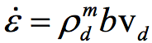
Irradiation and Creep
Irradiation accelerates creep, causing it to be significant at lower temperatures
Irradiation has little effect on diffusional creep, but it accelerates dislocation creep in cubic materials
The dislocation creep rate can be written as
ρ_{d}^{m} is the density of mobile dislocations
b is the burgers vector
v_{d} is the dislocation velocity
Gliding dislocations quickly get pinned by obstacles
As the dislocations absorb defects created by irradiation, they climb to different slip planes to avoid the obstacles
More interstitials are absorbed than vacancies due to the higher sink strength for interstitials

Slide 39
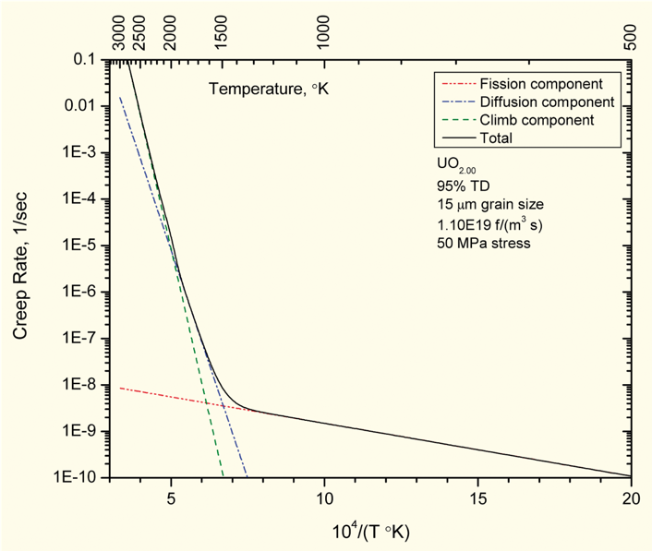
Fuel Creep
Like other materials, the fuel also undergoes creep
The fuel creep (In UO2) is a combination of diffusion creep and irradiation creep
It is expected that fuel creep plays a major role in dimensional change in metallic fuels, largely via N-H and Coble creep, but still unproven experimentally and no good creep models exist for metallic fuels

Slide 40
Summary
Many materials models for fuel are empirical and correlated to burnup
Fuel pellets change shape due to
Thermal expansion (increase in volume)
Densification (decrease in volume)
Swelling (increase in volume)
Creep (volume stays the same)
Fracture also decreases the gap, as fractures pieces shift outward

